Slide 1

ShowElement.dll
Gottfried Werner
Intergraph, Germany
gottfried.werner@intergraph.com
+49-5102-914126
02.7.2010
Version 1.0.11

Slide 2
ShowElement.dll
SP3D custom command to list:
  all Interface
  all Attributes
of a selected SP3D object

Slide 3
Features
Show attributes
Show members/properties
Navigate through parent/child relations

Slide 4
Usage Example
Select any Sp3d element
Start: Tools/Custom Comands:
  Command Progid: ShowElement.ShowObject
A form will appear:

Slide 5
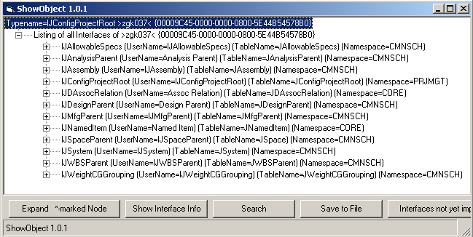
Interfaces of the Root Object

Slide 6
Order of output
For each interface there will be shown:
  Relations of the interface
  Attributes of the interface
  Properties and member functions or the text: interface specific information not available -

Slide 7
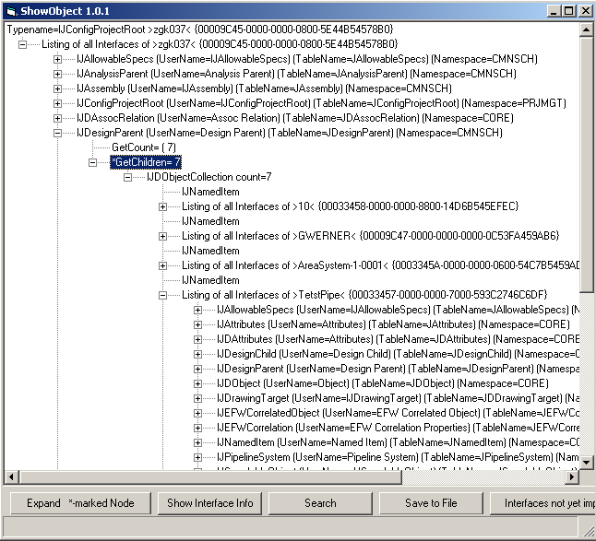
Expanding *-marked Nodes

Slide 8
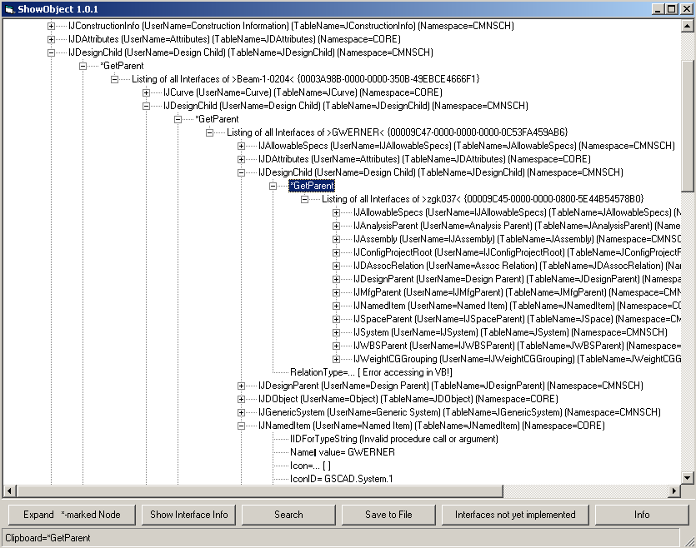
Expanding *-marked nodes

Slide 9
Example:
The following pages give an example, how the command can be used to find the name of an Attribute:

Slide 10
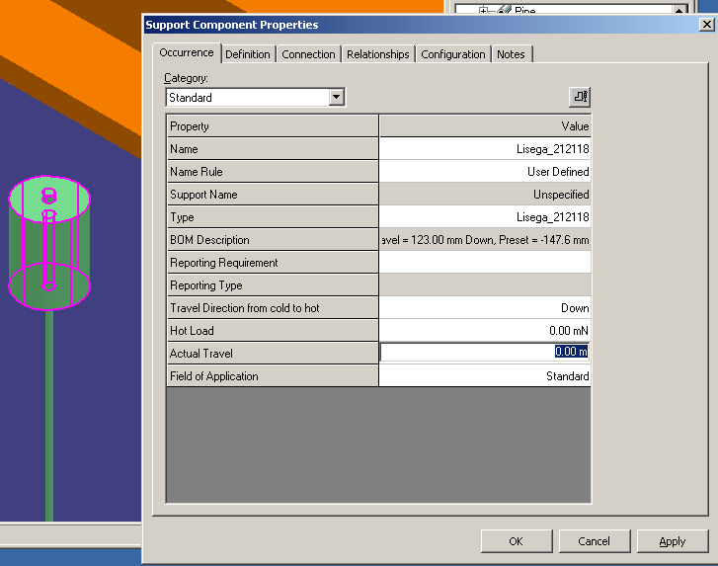
How to find the Attribute:
Actual Travel in the code

Slide 11
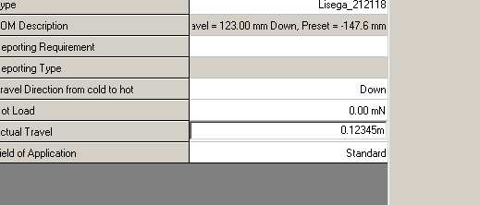
How to find the Attribute:
Actual Travel in the code
Enter some singular value:
Select the Hanger Component again and:

Slide 12
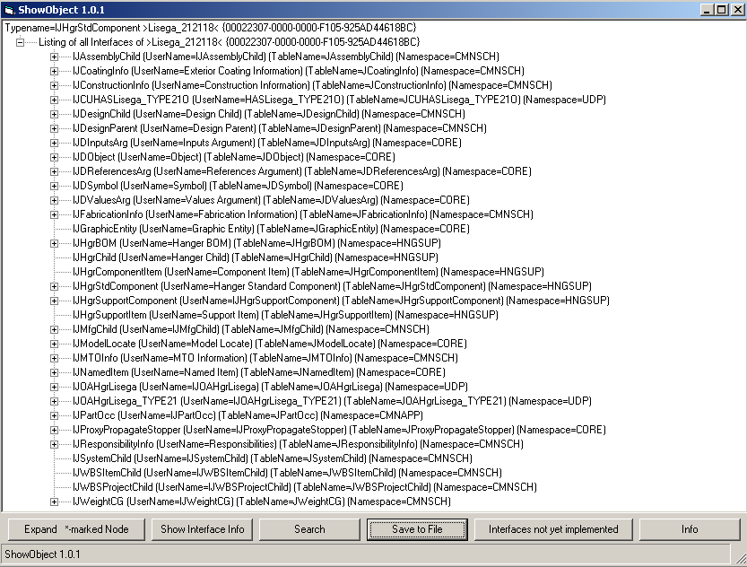
Call user command: ShowElement.ShowObject
click and enter: 123

Slide 13
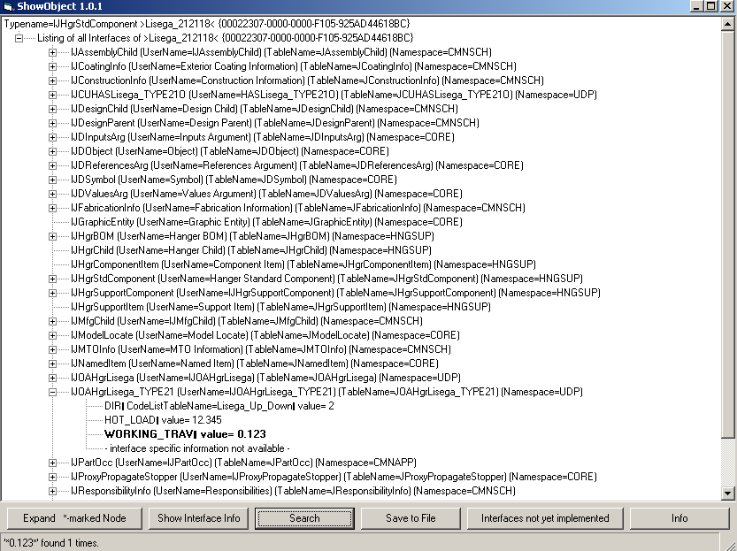
call Search for “123”
ActualTravel is called „Working_Trav“ and is in IJOAHgrLisega_Type21 - interface!

Slide 14
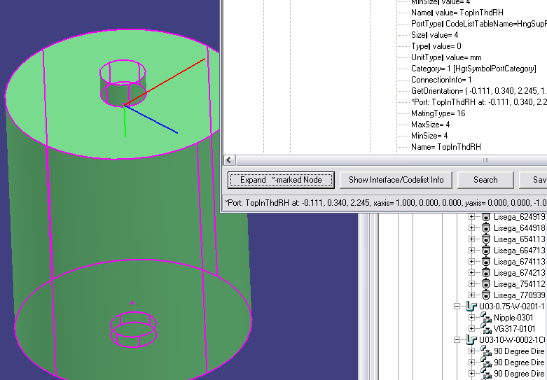
„Expanding Ports“
When Expanding a line *Port: the position and orientation of the port is displayed in the graphic:

Slide 15
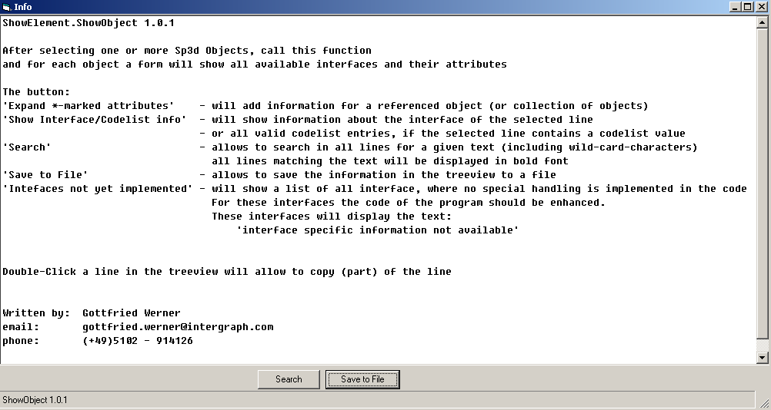
Info

Slide 16
ShowElement.ShowLines
My logfile shows some positions.
Where are these positions in the Sp3d View?
Example:
Start-end of sec steel structure
( -3.738, 7.045, 3.670 )
( -3.789, 7.045, 3.670 )
( -3.840, 7.045, 3.670 )
( -3.738, 7.045, 3.539 )
( -3.789, 7.045, 3.539 )
( -3.840, 7.045, 3.539 )
( -3.738, 7.045, 3.409 )
..........

Slide 17
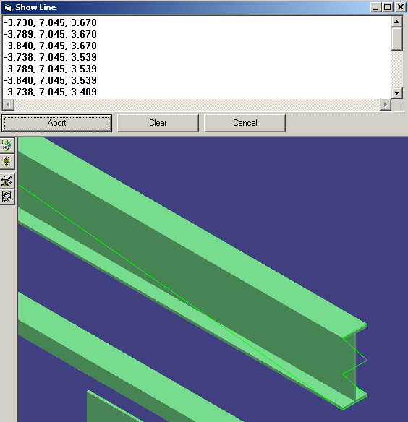
ShowElement.ShowLines
use Paste

Slide 18
Displaying Objects from other Command
When writing a SP3d command, it may be useful to display an object, use:
Dim oSH as Object
Set oSh=CreateObject(„ShowElement.ShowObject“)
Call oSH.Show(yourObject)
This will display the object as with ShowElement.ShowObject command
It can be used, to display non-selectable objects

Slide 19
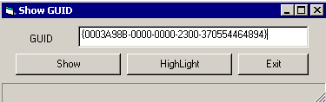
Displaying a GUID
When a Guid is know, call:
ShowElement.ShowGuid:
Show: will show interfaces
Highlight: will set object in selectset

Slide 20
Expanding the code
The Text: interface specific information not available – indicates, that the program code does not contain specific code for this interface.
Code can be added and will enhance the program.
The following pages describe, how code changes can be done.

Slide 21
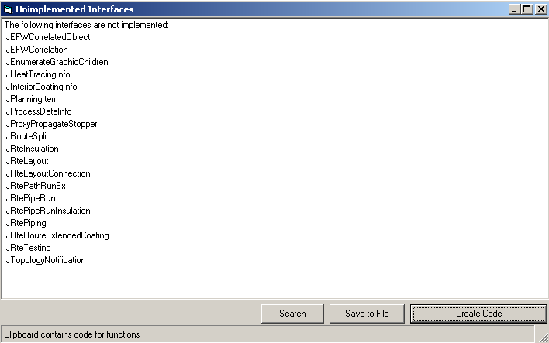
Adding code for new Interfaces
The button „Interfaces not yet implemented“ shows interfaces found during processing, which are not yet implemented in the code
Press button „Create Code“ to place pseudo code into clipboard

Slide 22
Adding Code for new Interfaces 2
Open VB-Project „User.vbp“
Open „Show.cls“
Insert Clipboard text in front of
  Public Sub Publish(colActions As Collection)
  e.g.:
  '#function,IJRtePipeRunInsulation
  '#property,,comment,Implementation missing
  '#endfunction
  '#function,IJRtePiping
  '#property,,comment,Implementation missing
  '#endfunction

Slide 23
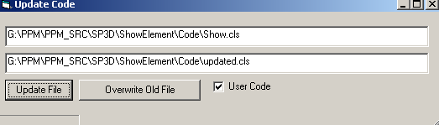
Adding Code for new Interfaces 3
Save Project and leave VB
Drop file „Show.cls“ onto „prjUpdateCode.exe
Press „Update File“ and „Overwrite File“
Open VB-Project „User.vbp“ again.

Slide 24
Adding Code for new Interfaces 4
There will be generated code:
  '#function,IJRtePipeRunInsulation
  Public Function outputIJRtePipeRunInsulation(Form As Object, Node1 As Node, o As Object) As Long
  Dim obj As IJRtePipeRunInsulation
  Dim Node2 As MSComctlLib.Node
  Dim Node3 As MSComctlLib.Node
  Dim sMsg As String
  outputIJRtePipeRunInsulation = -1
  On Error GoTo Handler
  Set obj = o
  If obj Is Nothing Then Exit Function
  '#property,,comment,Implementation missing
  Set Node2 = Form.TreeView1.Nodes.Add(Node1, tvwChild, , "=... [ Implementation missing]")
  outputIJRtePipeRunInsulation = 0
  Exit Function
  Handler:
  sMsg = sMsg & "[Error: " & Err.Description & "]"
  Resume Next
  End Function
  '#endfunction

Slide 25
Adding Code for new Interfaces 5
Check, if dll for IJRtePipeRunInsulation Is available using „Sp3dReferences“ Addin.
If not exist, delete code and replace by:
´#nomethod, IJRtePipeRunInsulation
´#endnomethod
If exist, start „Object Browser“ and look for method and properties
Copy the method definitions into code:
  '#property,Function GetInsulationSpec() As IJPipeInsulationSpec
  '#property,Function IsInsulationUserDefined() As Boolean
  '#property,Sub PutInsulationSpec(pInsulationSpec As IJPipeInsulationSpec)
  '#property,Sub PutInsulationSpec(pInsulationSpec As IJPipeInsulationSpec)
  '#property,Sub SetUserDefinedInsulation(lPurpose As Long, lMaterial As...

Slide 26
Adding Code for new Interfaces 3b
Save Project and leave VB
Drop file „Show.cls“ onto „prjUpdateCode.exe
Press „Update File“ and „Overwrite File“
Open VB-Project „User.vbp“ again.

Slide 27
Adding Code for new Interfaces 6
Compile the VB-project
All methods will now appear as „comment“ lines.
Modify pseudocode for lines, where the result is useful:
'#property,GetInsulationSpec As IJPipeInsulationSpec
'#property,IsInsulationUserDefined

Slide 28
Adding Code for new Interfaces 3b
Save Project and leave VB
Drop file „Show.cls“ onto „prjUpdateCode.exe
Press „Update File“ and „Overwrite File“
Open VB-Project „User.vbp“ again and compile.

Slide 29
Explaining the Pseudocode
A new Interface is specified by:
'#Function,<objectname>
...
'#EndFunction

Slide 30
Explaining the Pseudocode cont’d
Property declarations:
  for long, double, string:
  '#Property,<attributename>,
  for reference to other object:
  '#Property,<attributename> As <interface>
  '#Property,<attributename>,ref,<interface>
  for enums:
  '#Property,<attributename>,enum,<enumname>

Slide 31
Explaining the Pseudocode cont’d
Property declarations:
  for functions:
  '#Property,<attributename>, fun,<dslmo>
  for each parameter of type „double“,“string“,“long“, „IJDT4x4“, “object“ enter: d s l m o
  for properties, which should not be called:
  '#Property,<attributename>,comment,<text>

Slide 32
End
of Session

Slide 33
Titel

Slide 34
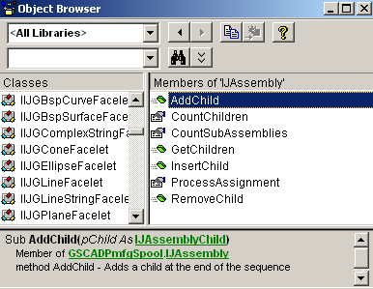
Adding code for Interface: IJAssembly
Open VB Object Browser and navigate to IJAssembly:

Slide 35
Adding code for Interface: IJAssembly
Open in VB „clsShow.cls“ and add Lines:
'#function,IJAssembly
'#Property,AddChild,comment,(pChild As IJAssemblyChild)
'#Property,CountChildren
'#Property,CountSubAssemblies
'#Property, GetChildren() As IJDTargetObjectCol
'#Property,InsertChild,comment,(Child As IJAssemblyChild, index As Long)
'#Property,ProcessAssignment,comment,As IJProcessAssignment
'#Property,RemoveChild,comment,(pChild As IJAssemblyChild)
'#endfunction

Slide 36
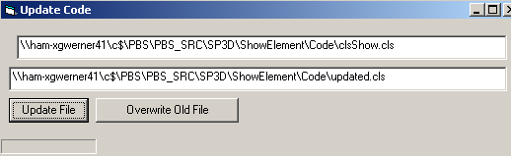
Adding code for Interface: IJAssembly
Save Project Group
Start Program: prjUpdateCode
Check, that „clsShow.cls“ is specified
Select „Update File“
Select „Overwrite Old File“

Slide 37
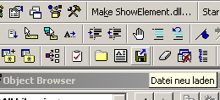
Adding code for Interface: IJAssembly
Use Button from MZTools to reload „clsShow.cls“
Code for „IJAssembly“ is created:

Slide 38
Adding code for Interface: IJAssembly
'#function,IJAssembly
Public Function outputIJAssembly(Form As frmShowElement, Node1 As Node, o As Object) As Long
Dim obj As IJAssembly
Dim Node2 As MSComctlLib.Node
Dim sMsg As String
outputIJAssembly = -1
On Error GoTo Handler
Set obj = o
If obj Is Nothing Then Exit Function
'#Property,AddChild,comment,(pChild As IJAssemblyChild)
Set Node2 = Form.TreeView1.Nodes.Add(Node1, tvwChild, , "AddChild=... [ (pChild As IJAssemblyChild)]")
'#Property,CountChildren
sMsg = "CountChildren= "
sMsg = sMsg & obj.CountChildren
Set Node2 = Form.TreeView1.Nodes.Add(Node1, tvwChild, , sMsg)
'#Property,CountSubAssemblies
sMsg = "CountSubAssemblies= "
sMsg = sMsg & obj.CountSubAssemblies
Set Node2 = Form.TreeView1.Nodes.Add(Node1, tvwChild, , sMsg)

Slide 39
Adding code for Interface: IJAssembly
'#Property,GetChildren() As IJDTargetObjectCol
sMsg = "*GetChildren()"
Set Node2 = Form.TreeView1.Nodes.Add(Node1, tvwChild)
Set o1 = Nothing
Set o1 = obj.GetChildren()
Set Node2.Tag = o1
Node2.Text = sMsg
'#Property,InsertChild,comment,(Child As IJAssemblyChild, index As Long)
Set Node2 = Form.TreeView1.Nodes.Add(Node1, tvwChild, , "InsertChild=... [ (Child As IJAssemblyChild, index As Long)]")
'#Property,ProcessAssignment,comment,As IJProcessAssignment
Set Node2 = Form.TreeView1.Nodes.Add(Node1, tvwChild, , "ProcessAssignment=... [ As IJProcessAssignment]")
'#Property,RemoveChild,comment,(pChild As IJAssemblyChild)
Set Node2 = Form.TreeView1.Nodes.Add(Node1, tvwChild, , "RemoveChild=... [ (pChild As IJAssemblyChild)]")
outputIJAssembly = 0
Exit Function
Handler:
sMsg = sMsg & "[Error: " & Err.Description & "]"
Resume Next
End Function
'#endfunction

